Slide 1
Volatility Is Rough

Slide 2
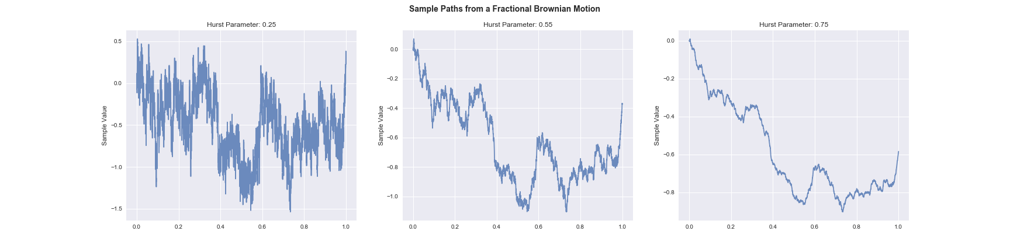
Brownian Motion Can be rough
Rough
Normal
Smooth

Slide 3
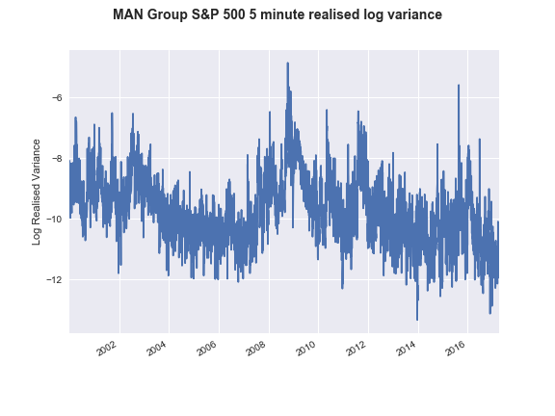
Volatility is rough
Rough volatility models can
Match properties of time series
Match volatility surface
And be time inhomogeneous – giving us stable surfaces!
Rough!

Slide 4
What is the problem here?
The traders problem
I have a strategy and I want to weight by forecast volatility
The risk managers problem
I have a portfolio and I want to know the risk
What’s my VaR?
The derivatives dealers problem
I have a derivative that cares about forecast volatility and the path
I want to know the volatility!

Slide 5
Stylized Volatility Facts

Slide 6
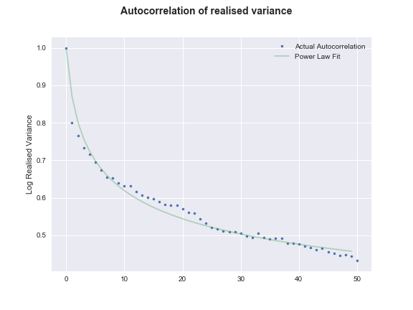
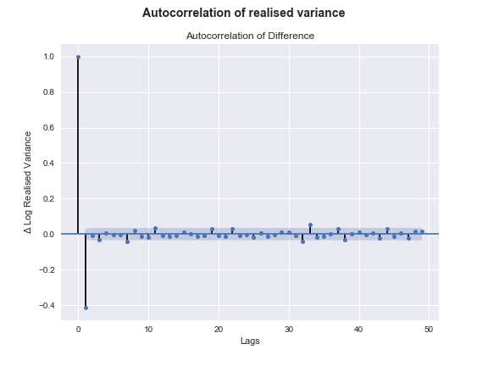
Autocorrelation of Variance
“Long memory”

Slide 7
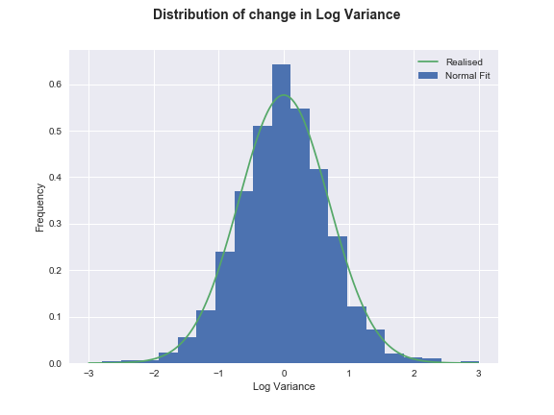
The Change in Log Variance is “Normally” Distributed

Slide 8
The Model

Slide 9
Where does it come from?
Trade level dynamics!
Given:
Order flow is highly endogenous
A given order influences orders over a long time period
Fractals! The properties scale linearly

Slide 10
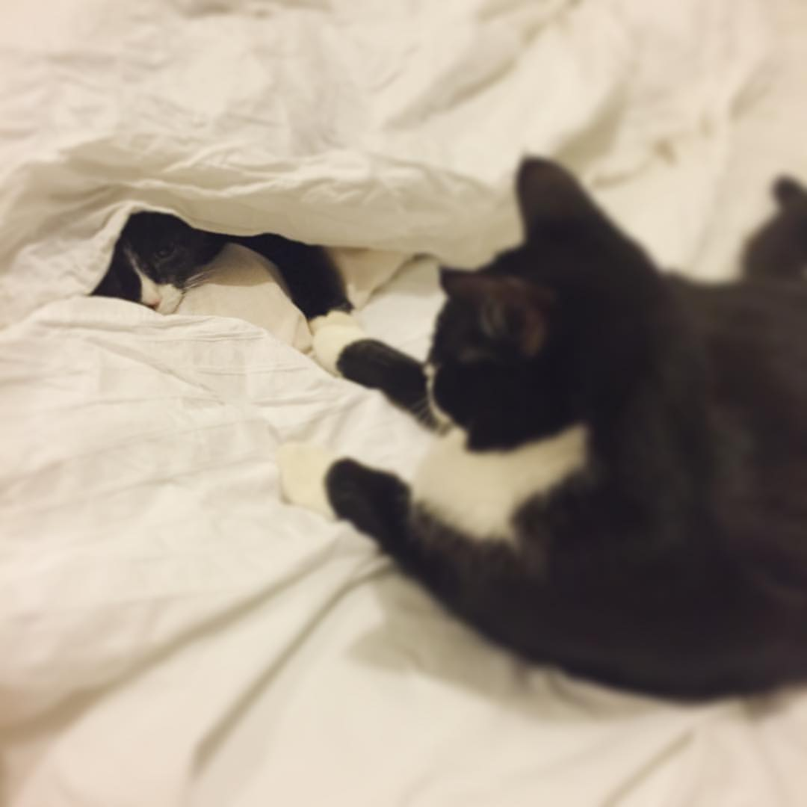

Slide 11
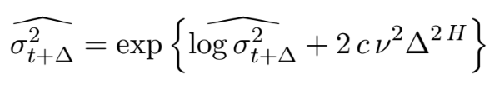
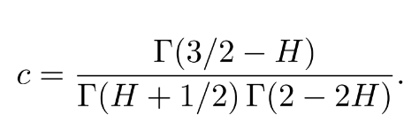
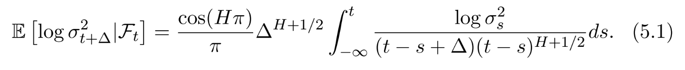
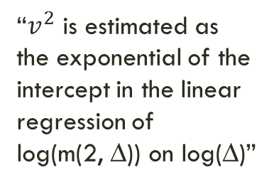
The math
Target variance!
(∆ periods ahead)
“$v^{2}$ is estimated as the exponential of the intercept in the linear regression of
log(m(2, ∆)) on log(∆)”

Slide 12
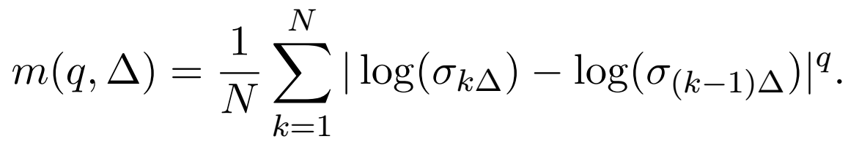
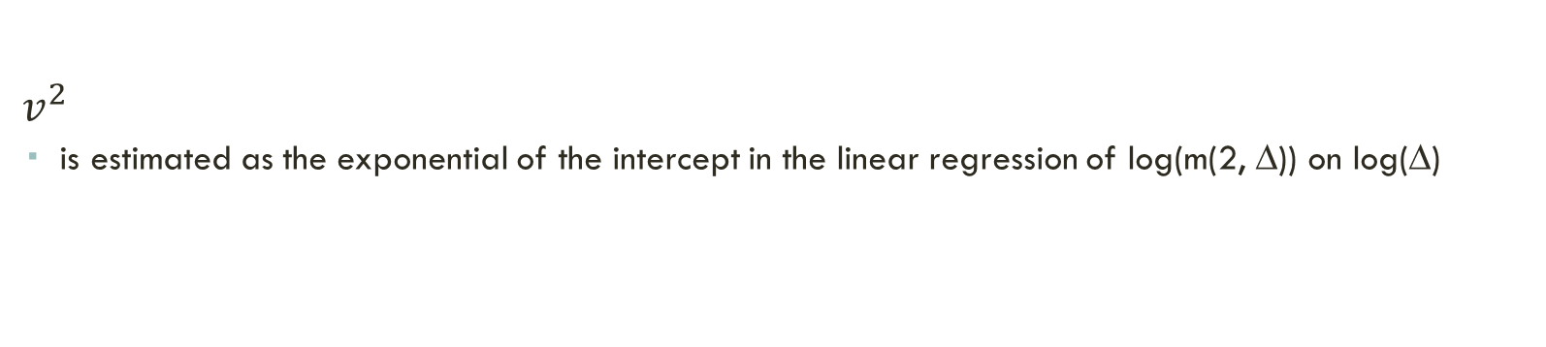
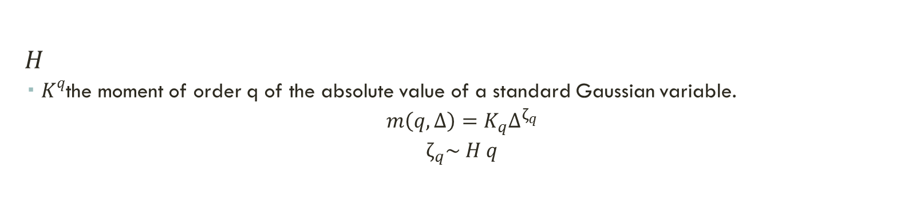

Things We Need To Estimate
$v^{2}$
is estimated as the exponential of the intercept in the linear regression of log(m(2, ∆)) on log(∆)
$H$
$K^{q}$the moment of order q of the absolute value of a standard Gaussian variable.
$$m\left(q, ∆\right)=K_{q}∆^{ζ_{q}}$$
$$ζ_{q}\sim H q$$
$K_{q}$ is the $q^{th}$ moment of the absolute value of a standard Gaussian variable

Slide 13
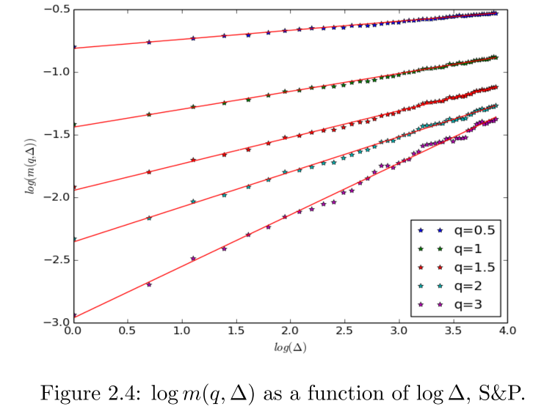

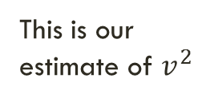
Results - $v2$
This is our estimate of $v^{2}$

Slide 14
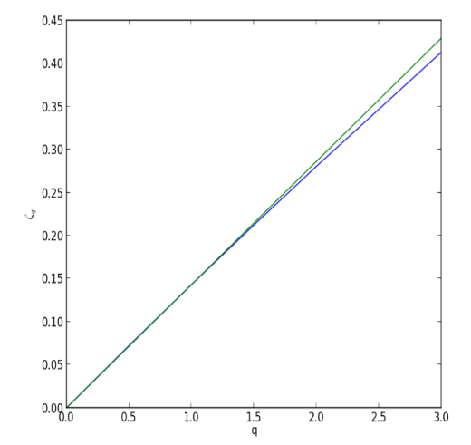

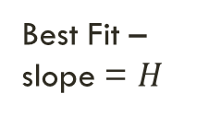

Results - $H$
Best Fit – slope = $H$
Estimate from data
$$ζ_{q}$$

Slide 15
Does it Work?

Slide 16
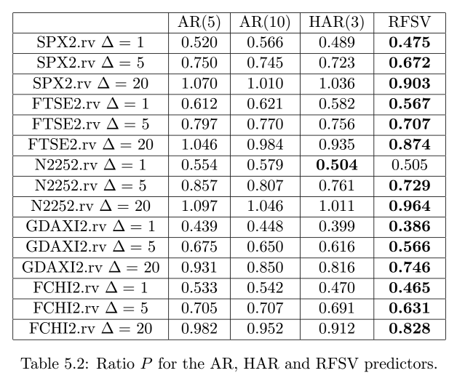
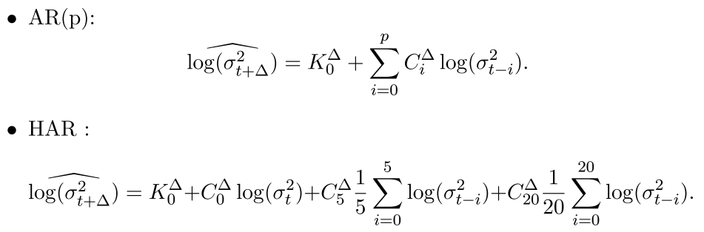
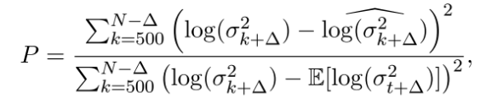
Results – Compared to AR and HAR models
Rough Vol outperforms AR and HAR models at 1, 5, and 20 day volatility forecasts
Nikkei 225
And Rough vol is more parsimonious – AR and HAR have to be recalibrated per forecast horizon
DAX
AR and HAR strategy definitions
CAC 40

Slide 17
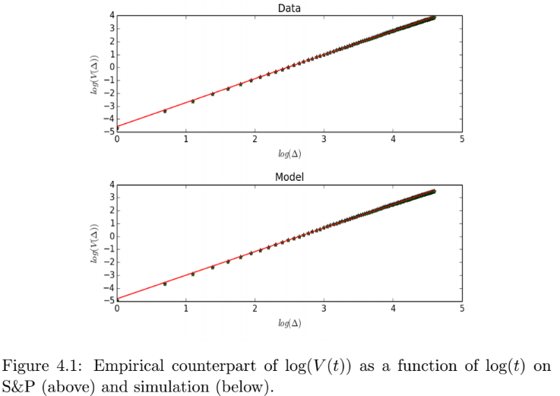
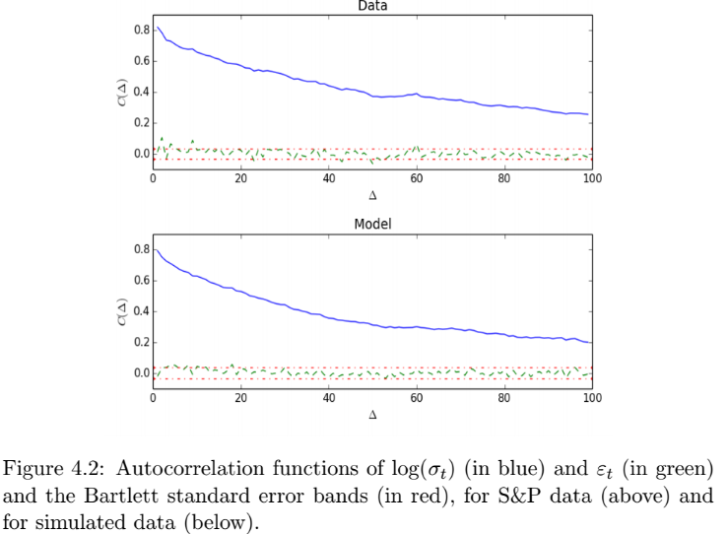
Results – Volatility Doesn’t Actually Have a Long Memory
Standard test for long memory
Rough Vol model also passes – but it doesn’t actually have a long memory!
It has persistence, but does not decay with a power law

Slide 18
Closing Remarks

Slide 19
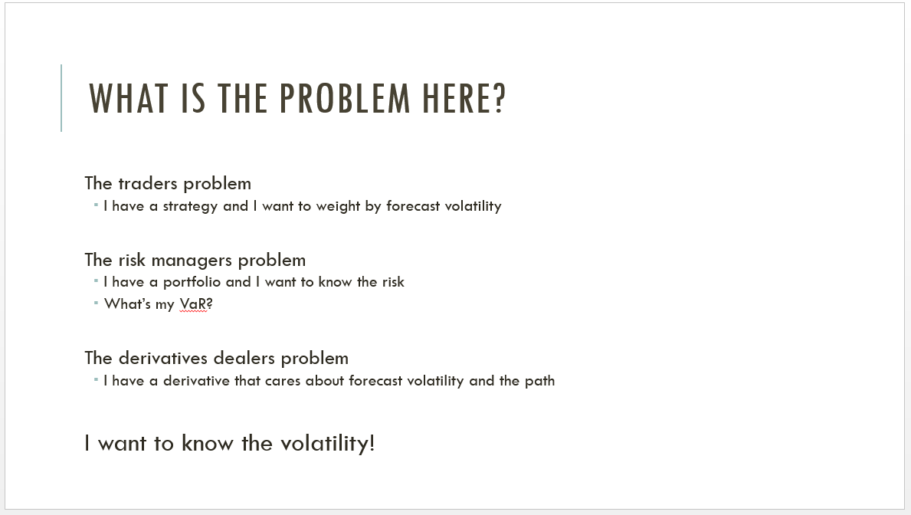
Tying it all together
Parsimonious
Same parameters used to look ahead any amount
Accurate
Estimated on high frequency data
Better than AR and HAR anyway
Generates “long memory”
Comes from realistic dynamics
Produces realistic dynamics
If deceptive!

Slide 20
Questions?
What volatility models do people use?
Autocorrelation of trade signs?

